Slide 1
XGT Modular Outdoor Platform Setting the standard for DOCSIS 4.0 taps
Maarten Markhorst
Director of Connected Home products

Slide 2
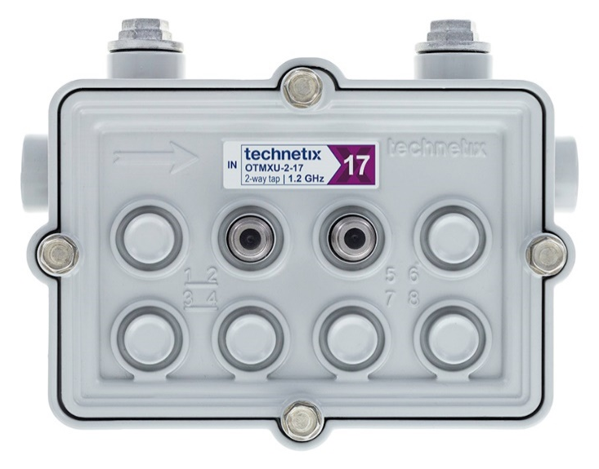
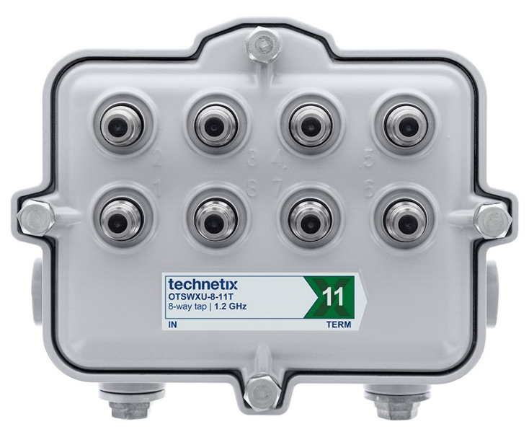
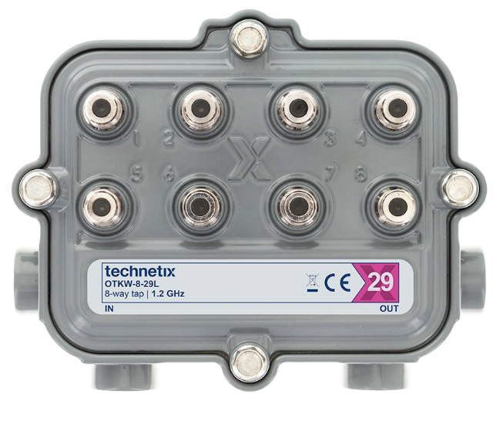
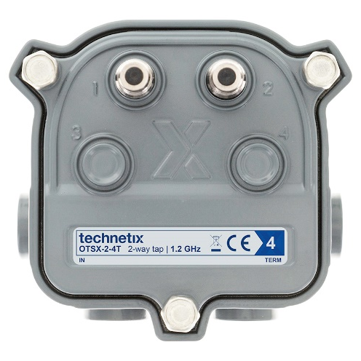
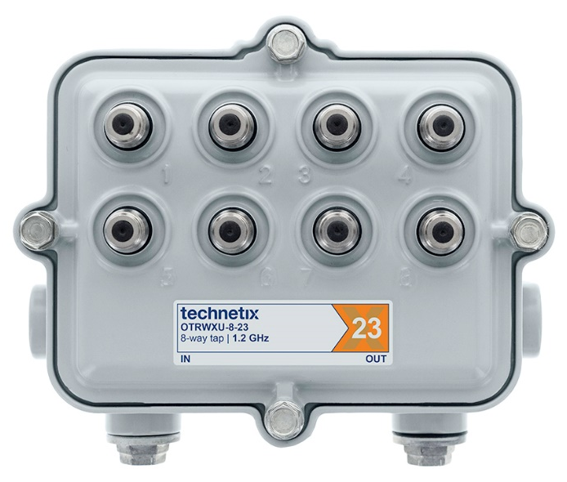
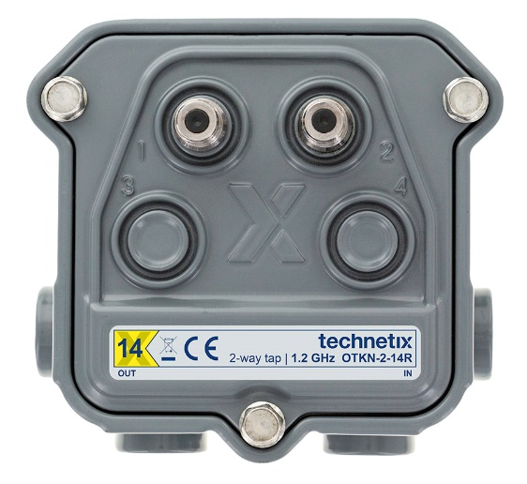
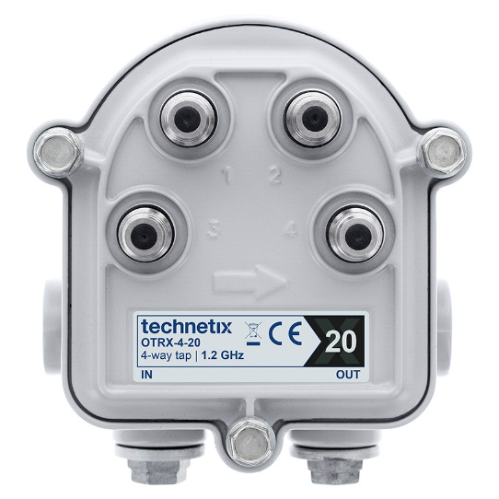
Large legacy base of installed multitaps

Slide 3
Technetix XGT - gigabit modular multitaps*
No make-before-break switch, prevents AC interruption and a possible RPD reboot
3 GHz backbox for future upgrades
Signal conditioning plug-in in faceplate
Special screwless connector design for 3 GHz performance. Fast, reliable and easy installation
1.8 GHz faceplate can be replaced without breaking the power or RF signals down the line
1.8 GHz coupler modules to determine the tap value and accommodate power passing of 15 A
* Patents pending

Slide 4
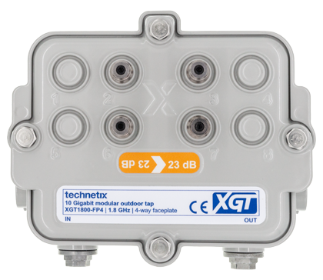
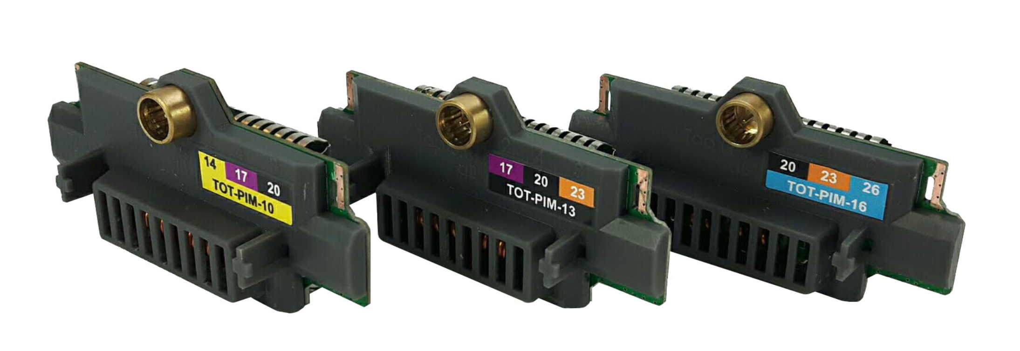
Technetix XGT – inventory savings
Legacy portfolio 60 - 150 SKUs for multitaps
XGT platform 13 SKUs for multitaps
Inventory management savings across the whole supply chain
Save on forecasting, supply chain operations, stock levels in the main warehouse, distribution hubs and installation partners.
Coupler Module | With 2-way faceplate (dB) | With 4-way faceplate (dB) | With 8-way faceplate (dB)
XGT1800-CM0T | 4T | 8T | 11T
XGT1800-CM04 | 8 | 11 | 14
XGT1800-CM07 | 11 | 14 | 17
XGT1800-CM10 | 14 | 17 | 20
XGT1800-CM13 | 17 | 20 | 23
XGT1800-CM16 | 20 | 23 | 26
XGT1800-CM19 | 23 | 26 | 29
XGT1800-CM22 | 26 | 29 | 32
XGT1800-CM25 | 29 | 32 | 35

Slide 5
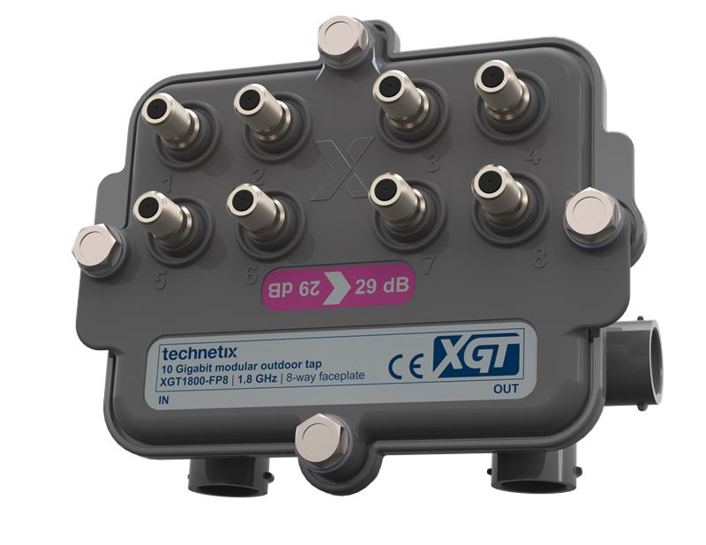
Technetix XGT - questions?
Maarten Markhorst
Director of Connected Home products
maarten.markhorst@technetix.com

Slide 6
Thank You!

